Slide 1

Classic ML Problems
Study Group
Titanic Survival Prediction
Host: Deepika Kamabathula June/2021

Slide 2
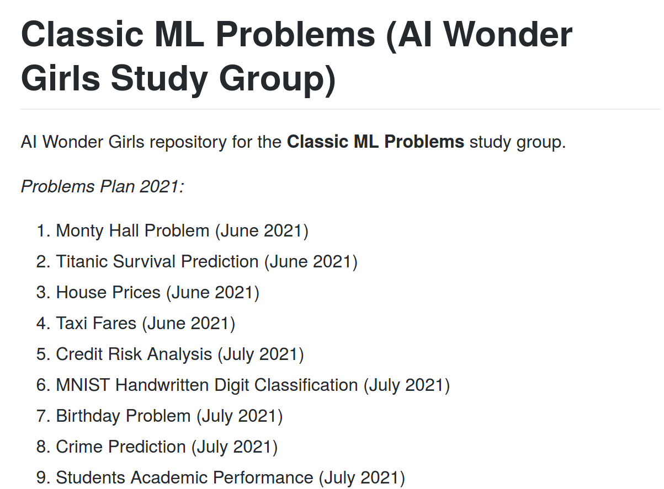
https://github.com/rogomes/aiwondergirls-classic-ML-problems

Slide 3
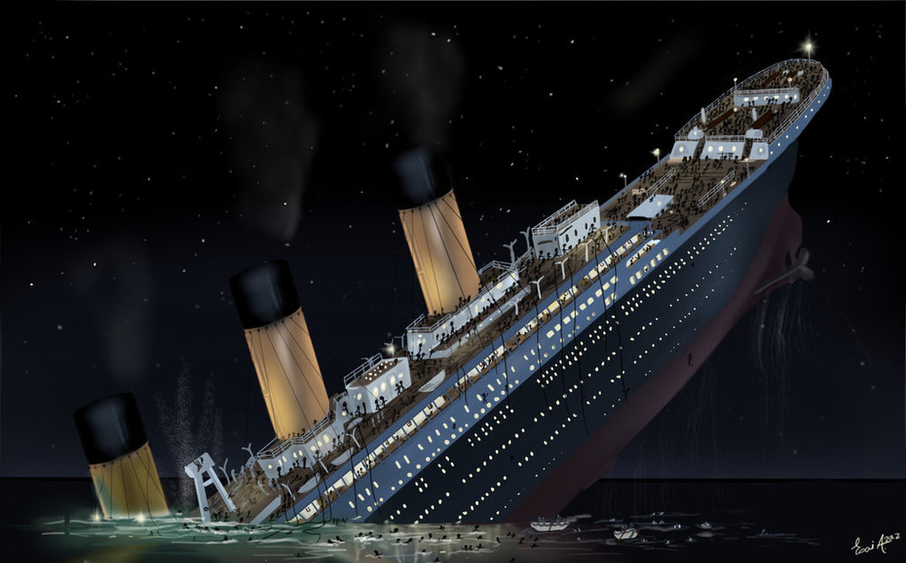
Intro...
On April 15, 1912, during her maiden voyage, the Titanic sank after colliding with an iceberg, killing 1502 out of 2224 passengers and crew. Translated 32% survival rate.
One of the reasons that the shipwreck led to such loss of life was that there were not enough lifeboats for the passengers and crew.
Although there was some element of luck involved in surviving the sinking, some groups of people were more likely to survive than others, such as women, children, and the upper-class.

Slide 4
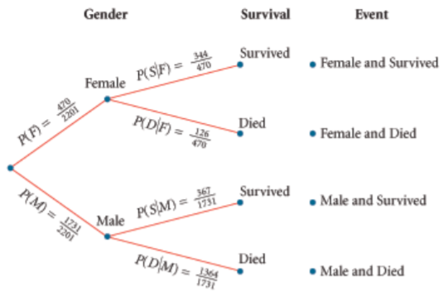
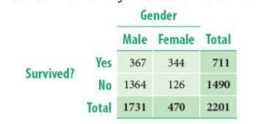
Case of Conditional probability
Notes:
P(F and S) = P(F)⋅P(S F) = Probability (Female)  Probability (Survived given Female) = 470/2201  344/470 = 344/2201 The Multiplication Rule: P(A and B) = P(A) P(B|A) P(A and B) = P(B) P(A|B)
344/2201 (or 21%) of all the passengers were female, and 344/470 (or 73%) of female passengers survived. P(female and survived) = P(female) P(survived | female) = (0.21)(0.73) = 15.33% (or 344/2201)

Slide 5
Machine Learning Problem
We will further look at how Machine Learning can be used to predict whether a passenger has survived or not.

